Slide 1
Scored-Based Diffusion Models for Detail-Preserving Point Cloud Denoising

Slide 2
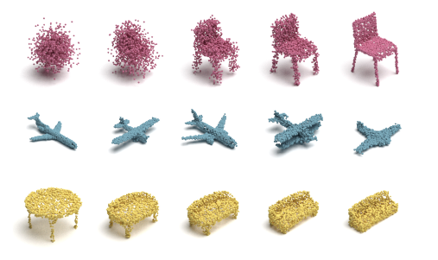
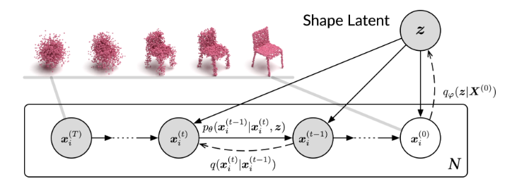
1. Inspiration of Project
Diffusion Probabilistic Models for 3D Point Cloud Generation
Using Diffusion Model and Shape Latent to generate Point Cloud.
Luo, Shitong, and Wei Hu. "Diffusion probabilistic models for 3d point cloud generation." Proceedings of the IEEE/CVF Conference on Computer Vision and Pattern Recognition. 2021.

Slide 3
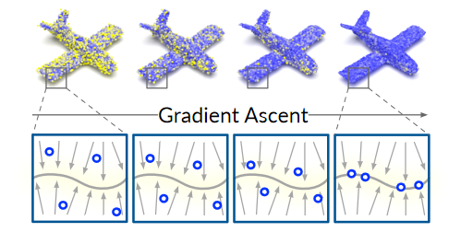
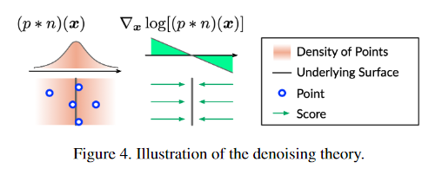
1. Inspiration of Project
Score-based point cloud denoising
Score-based models keep more detailed of point cloud at low noise.
Luo, Shitong, and Wei Hu. "Score-based point cloud denoising." Proceedings of the IEEE/CVF International Conference on Computer Vision. 2021.

Slide 4
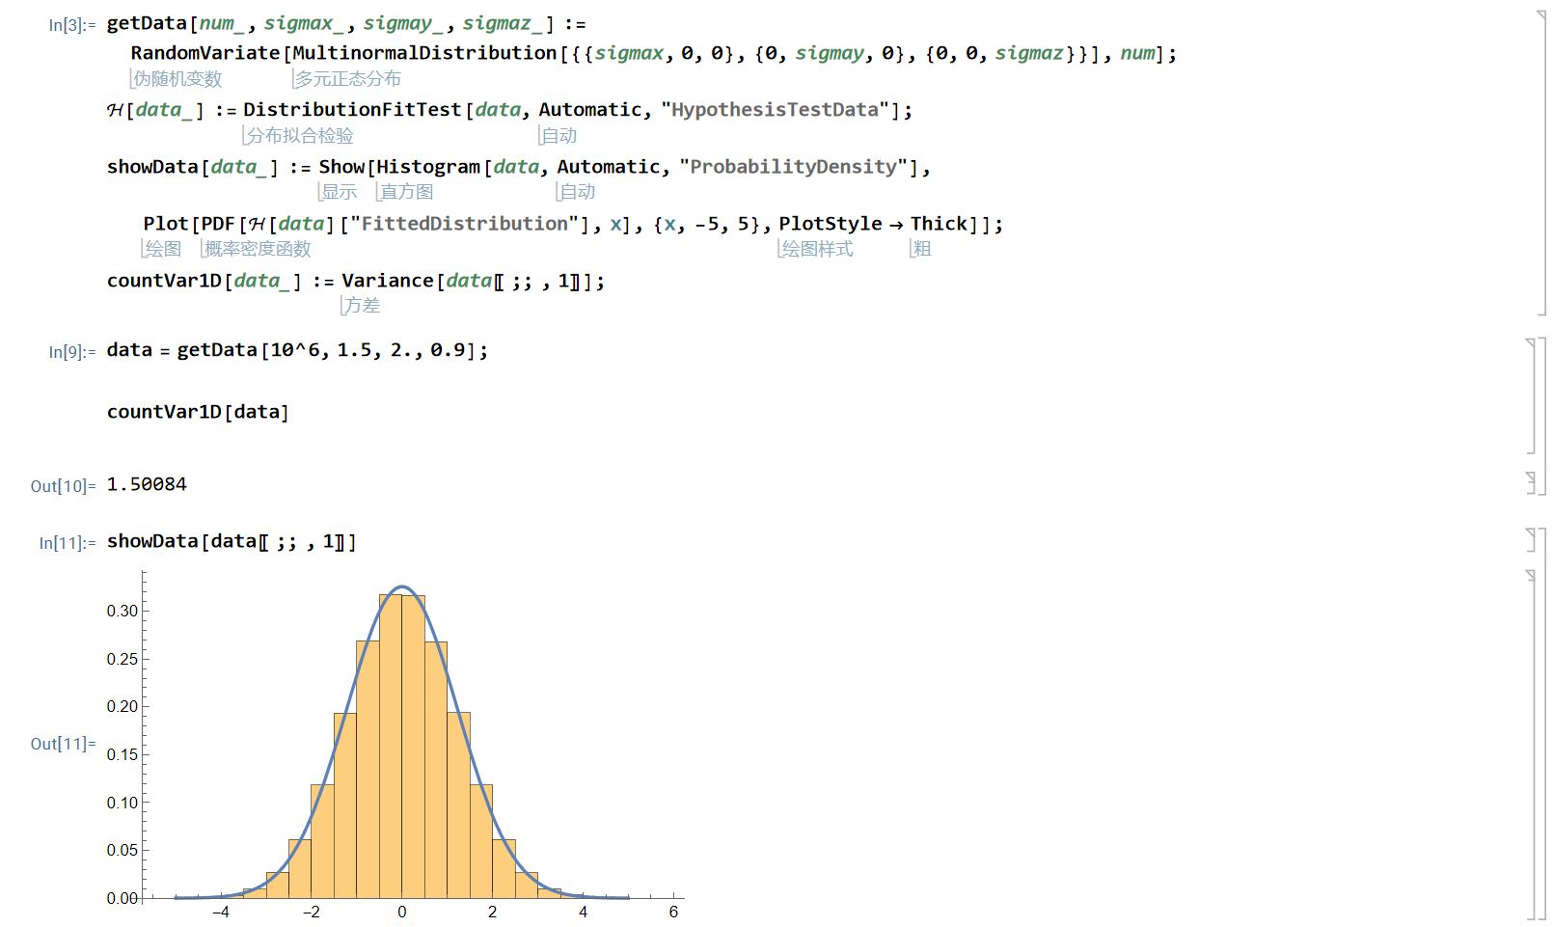
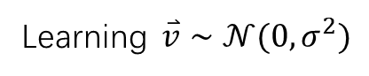

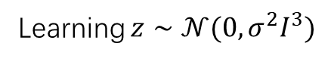

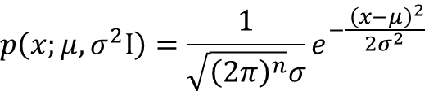
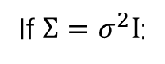

1. Inspiration of Project
About multivariate normal distribution
$$p\left(x;μ,Σ\right)=\frac{1}{\sqrt{{\left(2π\right)}^{n}\left|Σ\right|}}e^{−\frac{{\left(x−μ\right)}^{T}Σ^{−1}(x−μ)}{2}}$$
Multi Normal Distribution:
$$p\left(x;μ,σ^{2}I\right)=\frac{1}{\sqrt{{\left(2π\right)}^{n}}σ}e^{−\frac{ {\left(x−μ\right)}^{2}}{2σ^{2}}}$$
If $Σ=σ^{2}I$:
Associated Diffusion and Score-based models:
Learning $z∼𝒩(0,σ^{2}I^{3})$
$$⇔$$
Learning $\overset{⃑}{v}∼𝒩(0,σ^{2})$
$$⇔$$

Slide 5
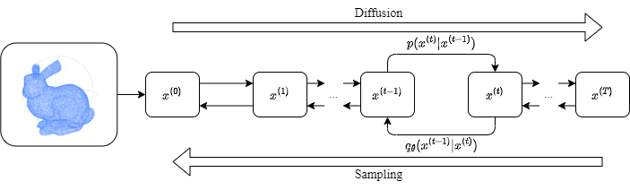
2. Introduction of Project
Score-Based Diffusion Point Cloud Denoising
Point cloud denoising is a classical problem. When sampling a point cloud on an object, the results are unavoidably affected by noise.
Users prefer to use the tools at low learning cost, i.e. input the noisy point cloud and output a clean point cloud directly. Deep learning is an effective method.
Both Diffusion model and Score-Based model are successful in image denoising.
Score-based is proven to be effective in point cloud denoising. With the suitable constraints, Score-based can keep more details of low-noise point cloud.
Diffusion models allow efficient processing of details in the image domain.

Slide 6
2. Introduction of Project
Score-Based Diffusion Point Cloud Denoising, SBD
Noise
Point Cloud
Input
SBD
Output
Clear
Point Cloud
Novelty:
Point cloud denoising for different levels of noise.
Keeping details for low-noise point cloud.
Fill the gap of Diffusion in point cloud denoising.
Challenge:
A relationship between Score-based models and Gaussian noise should be defined.
A Diffusion sampling method that can output high-detail point cloud should be designed.
Image Ref: Luo, Shitong, and Wei Hu. "Score-based point cloud denoising." Proceedings of the IEEE/CVF International Conference on Computer Vision. 2021.

Slide 7
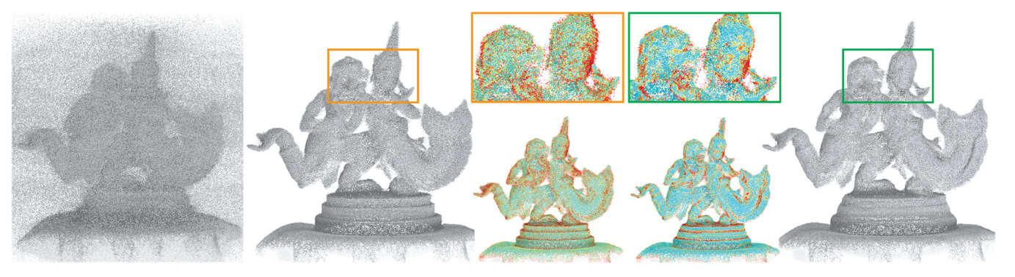
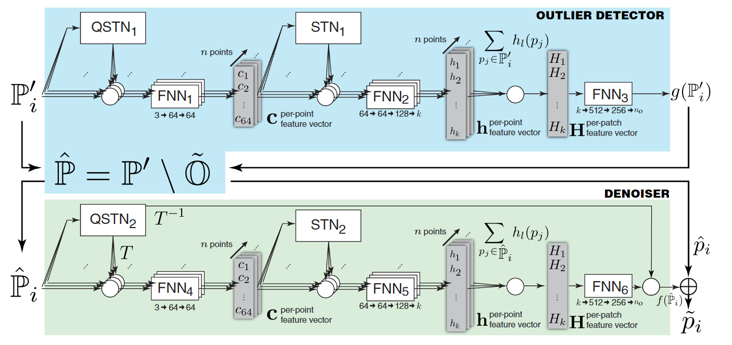
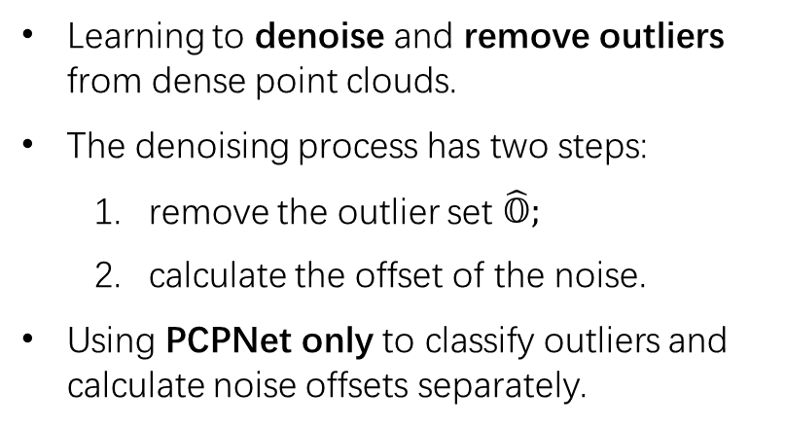
3. Existing Works (Point Cloud Denoising)
Point Clean Net
Learning to denoise and remove outliers from dense point clouds.
The denoising process has two steps:
remove the outlier set $\hat{𝕆}$;
calculate the offset of the noise.
Using PCPNet only to classify outliers and calculate noise offsets separately.
Rakotosaona, Marie‐Julie, et al. "Pointcleannet: Learning to denoise and remove outliers from dense point clouds." Computer Graphics Forum. Vol. 39. No. 1. 2020.
Notes:
此处罗利的是一些非常经典的模型。

Slide 8
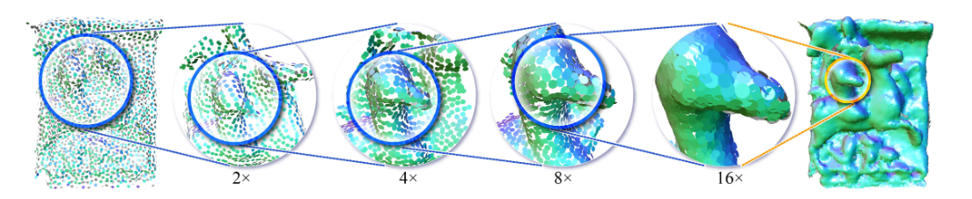
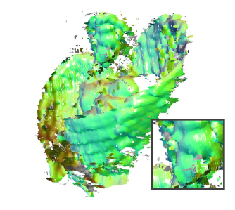
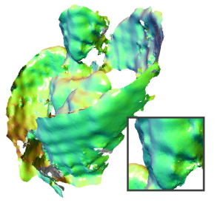
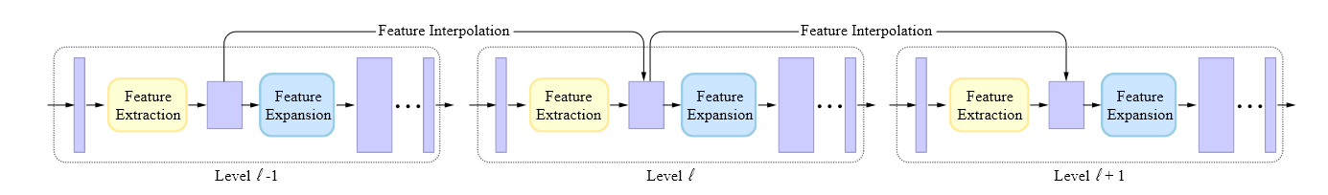
3. Existing Works (Point Cloud Denoising)
Patch-based Upsampling Denoising
An upsampling method that can be used to achieve point cloud denoising.
Input a noisy point cloud, output a clear dense point cloud with high-detail.
Yifan, Wang, et al. "Patch-based progressive 3d point set upsampling." Proceedings of the IEEE/CVF Conference on Computer Vision and Pattern Recognition. 2019.

Slide 9
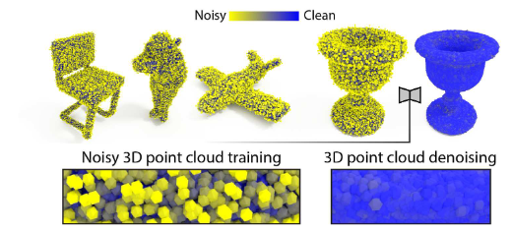
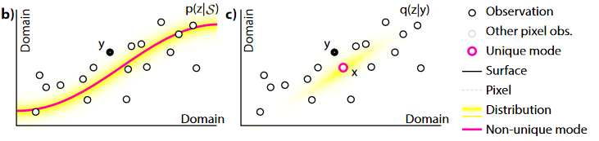
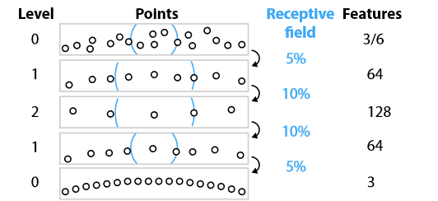
3. Existing Works (Point Cloud Denoising)
Total Denoising
Introducing a priori distribution term to fit the 3D point cloud manifold for unsupervised denoising.
Multi-level denoising with multiple neighborhood sizes.
Hermosilla, Pedro, Tobias Ritschel, and Timo Ropinski. "Total denoising: Unsupervised learning of 3d point cloud cleaning." Proceedings of the IEEE/CVF international conference on computer vision. 2019.

Slide 10
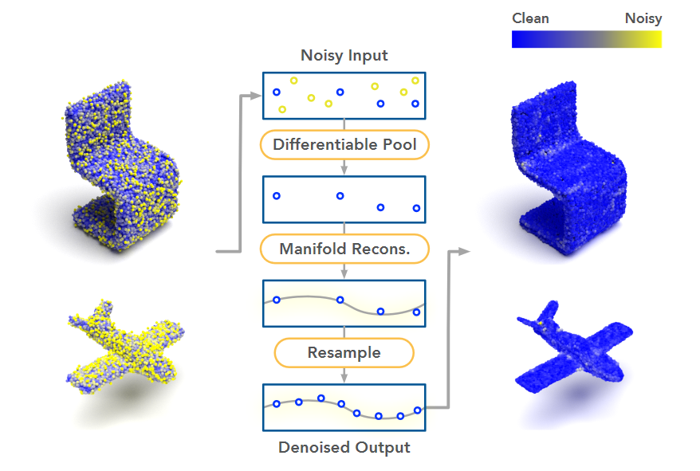
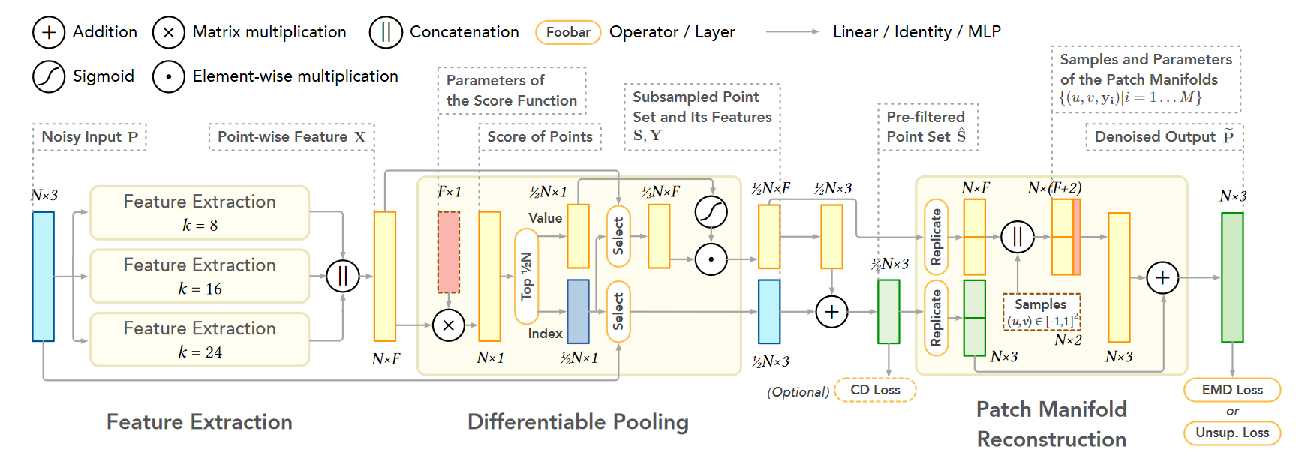
3. Existing Works (Point Cloud Denoising)
Differentiable Manifold Reconstruction
Using underlying manifold from differentiable subsampled points and their neighborhood feature to capture intrinsic surface structures.
Using upsampling method to sample points from the manifold.
Low-noise point cloud only.
Luo, Shitong, and Wei Hu. "Differentiable manifold reconstruction for point cloud denoising." Proceedings of the 28th ACM international conference on multimedia. 2020.

Slide 11
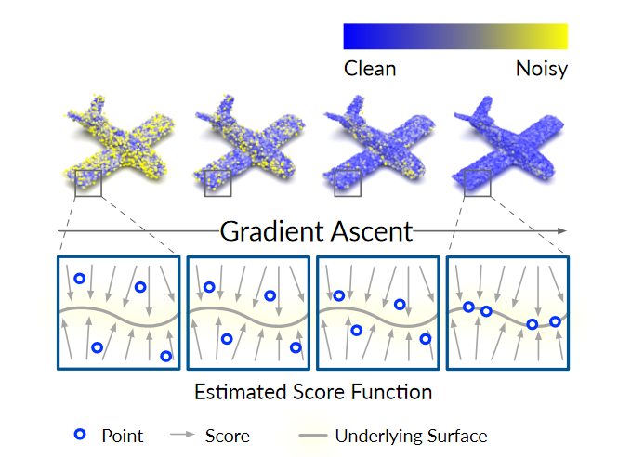
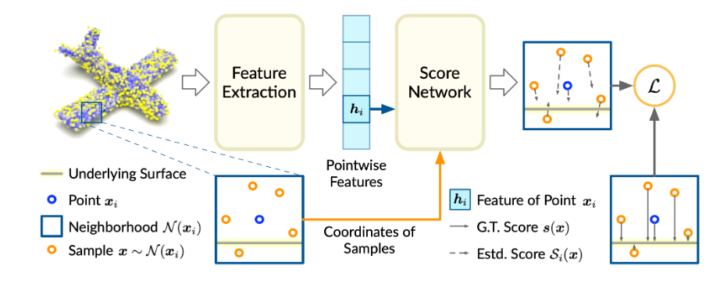
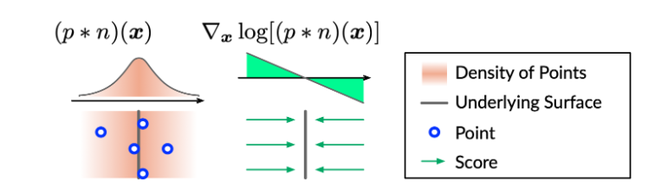
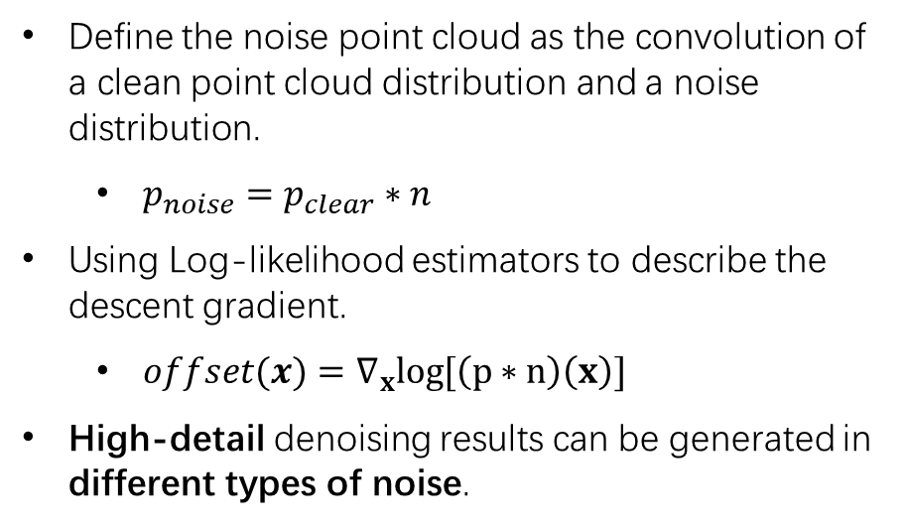
3. Existing Works (Point Cloud Denoising)
Score-based Method
Define the noise point cloud as the convolution of a clean point cloud distribution and a noise distribution.
$p_{noise}=p_{clear}∗n$
Using Log-likelihood estimators to describe the descent gradient.
$offset(x)=∇_{x}log[\left(p∗n\right)\left(x\right)]$
High-detail denoising results can be generated in different types of noise.
Luo, Shitong, and Wei Hu. "Score-based point cloud denoising." Proceedings of the IEEE/CVF International Conference on Computer Vision. 2021.

Slide 12
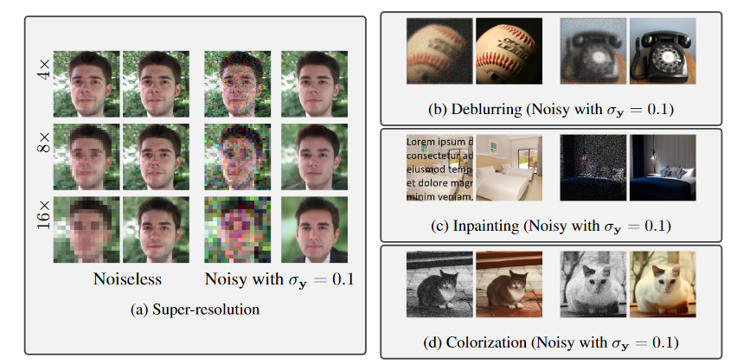
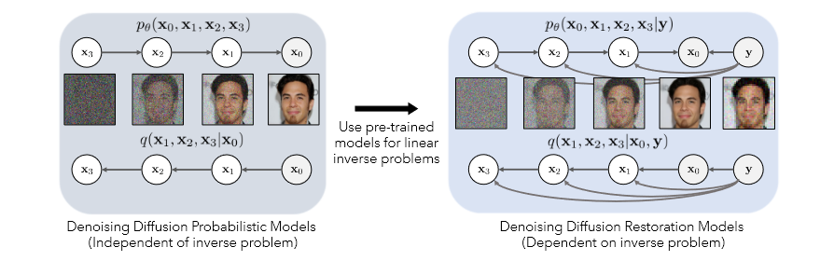
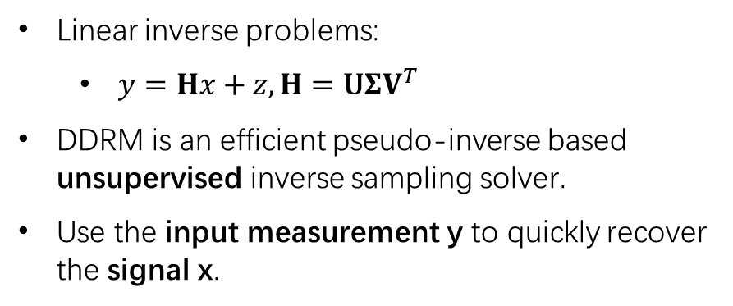
4. Existing Works (Diffusion Image Denoising)
Denoising Diffusion Restoration Models, DDRM
Linear inverse problems:
$y=Hx+z, H=UΣV^{T}$
DDRM is an efficient pseudo-inverse based unsupervised inverse sampling solver.
Use the input measurement y to quickly recover the signal x.
Kawar, Bahjat, et al. "Denoising diffusion restoration models." arXiv preprint arXiv:2201.11793 (2022).

Slide 13
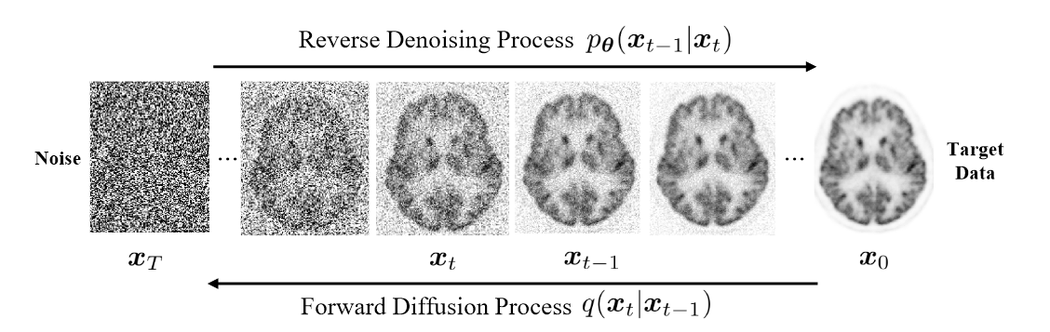
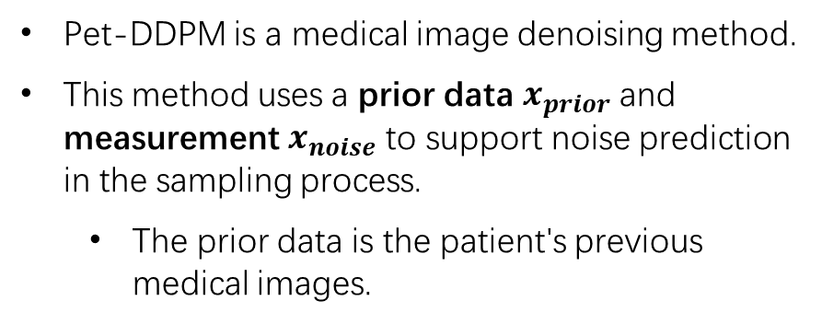

4. Existing Works (Diffusion Image Denoising)
PET image denoising based on DDPM, Pet-DDPM
Pet-DDPM is a medical image denoising method.
This method uses a prior data $x_{prior}$ and measurement $x_{noise}$ to support noise prediction in the sampling process.
The prior data is the patient's previous medical images.
$x_{t−1}=\frac{1}{\sqrt{α_{t}}} \left[x_{t}−\frac{β_{t}}{\sqrt{1−α_{t}}} ε_{ \hat{θ}}\left(x_{t},t,x_{prior}\right)\right]−\frac{σ_{t}^{2}}{σ_{d}^{2}}\left(x_{noise}−x_{t}\right)+σ_{t}z$
Gong, Kuang, et al. "PET image denoising based on denoising diffusion probabilistic models." arXiv preprint arXiv:2209.06167 (2022).

Slide 14
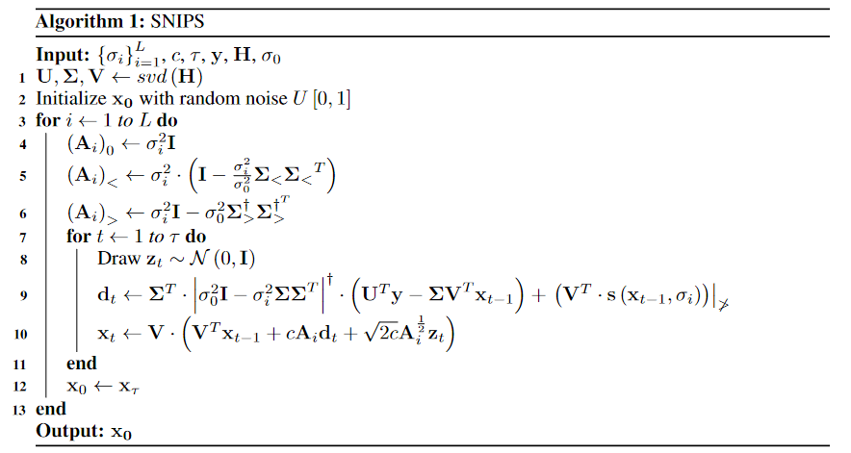
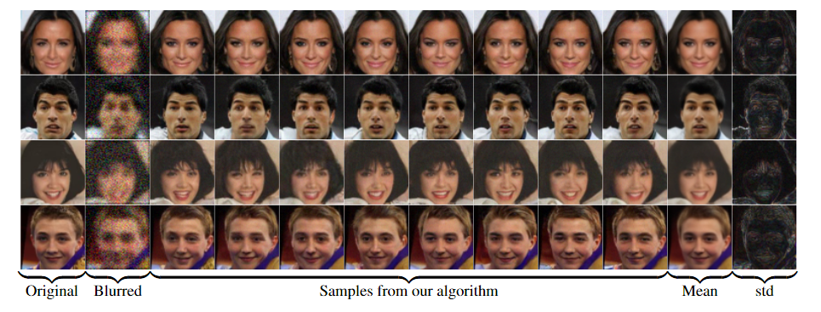
5. Existing Works (Other works)
Solving Noisy Inverse Problems Stochastically, SNIPS
SNIPS is a Score-based method.
SVD-based pseudo-inverse solves linear inverse problems.
Denoising process is accomplished using Score-based Method.
Kawar, Bahjat, Gregory Vaksman, and Michael Elad. "SNIPS: Solving noisy inverse problems stochastically." Advances in Neural Information Processing Systems 34 (2021): 21757-21769.

Slide 15
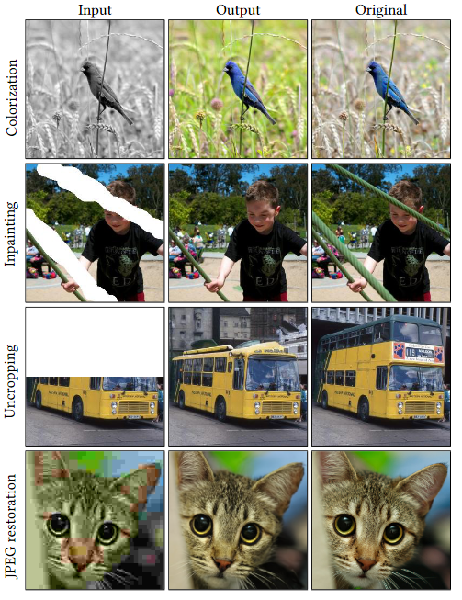
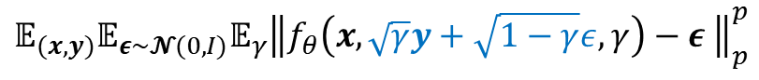
5. Existing Works (Other works)
Image-to-Image Diffusion Models, Palette
Palette is a multi-task diffusion model.
It is a unified framework for image-to-image translation based on conditional diffusion models.
They found that the ImageNet unified evaluation protocol was also applicable to the Diffusion image processing task.
$$𝔼_{(x,y)}𝔼_{ε∼𝓝(0,I)}𝔼_{γ}{\left\|f_{θ}\left(x,\sqrt{γ}y+\sqrt{1−γ}ε,γ\right)−ε \right\|}_{p}^{p}$$
Saharia, Chitwan, et al. "Palette: Image-to-image diffusion models." ACM SIGGRAPH 2022 Conference Proceedings. 2022.

Slide 16
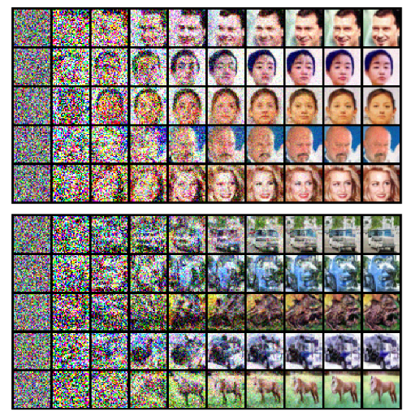
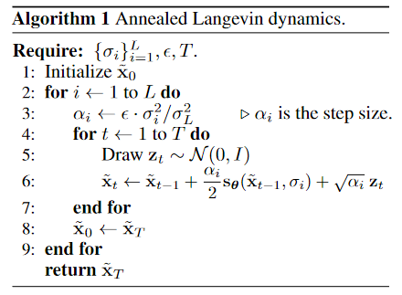

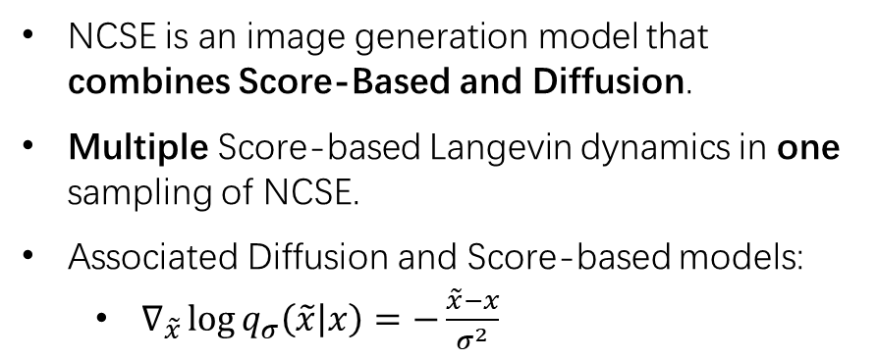
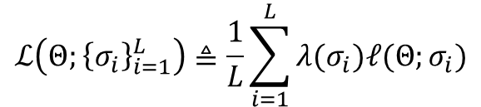
5. Existing Works (Other works)
Generative Modeling by Estimating Gradients of the Data Distribution, NCSE
NCSE is an image generation model that combines Score-Based and Diffusion.
Multiple Score-based Langevin dynamics in one sampling of NCSE.
Associated Diffusion and Score-based models:
$∇_{\tilde{x}}\log{q_{σ}\left(\tilde{x} | x\right)=−\frac{\tilde{x}−x}{σ^{2}}}$
$ℓ(Θ;σ)≜\frac{1}{2}𝔼_{p_{data}\left(x\right)}𝔼_{\tilde{x}∼𝒩\left(x,σ^{2}I\right)}\left[{\left\|s_{Θ}\left(\tilde{x},σ\right)+\frac{\tilde{x}−x}{σ^{2}}\right\|}_{2}^{2}\right]$
$$ℒ\left(Θ;{\left\{σ_{i}\right\}}_{i=1}^{L}\right)≜\frac{1}{L}\sum_{i=1}^{L}{λ(σ_{i})ℓ(Θ;σ_{i})}$$
Song, Yang, and Stefano Ermon. "Generative modeling by estimating gradients of the data distribution." Advances in Neural Information Processing Systems 32 (2019).

Slide 17
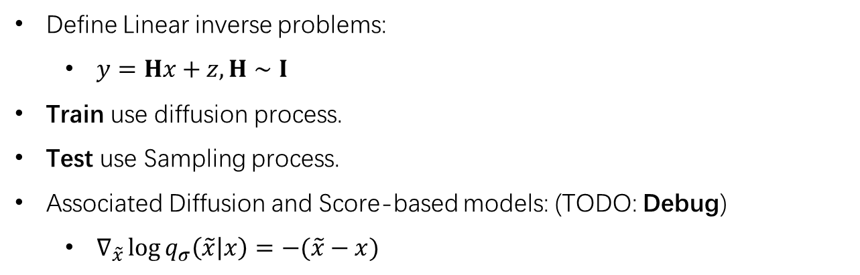
6. Potential Solution
Overview
Define Linear inverse problems:
$y=Hx+z, H∼I$
Train use diffusion process.
Test use Sampling process.
Associated Diffusion and Score-based models: (TODO: Debug)
$∇_{\tilde{x}}\log{q_{σ}\left(\tilde{x} | x\right)=−(\tilde{x}−x)}$

Slide 18
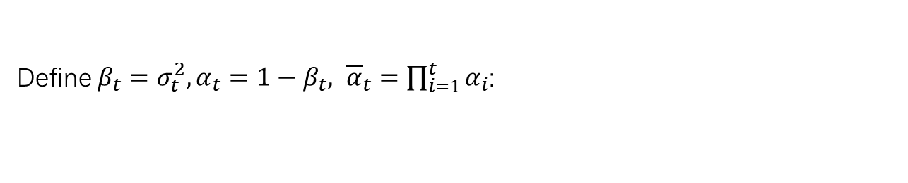



6. Potential Solution
Forward Process (Diffusion)
Forward:
$$q\left(x^{\left(t\right)} | x^{\left(t−1\right)}\right)=𝒩\left(x^{\left(t\right)};\sqrt{1−β_{t}}x^{\left(t−1\right)},β_{t}I\right), q\left(x_{1:T} | x^{\left(0\right)}\right)=\prod_{t=1}^{T}{q\left(x^{\left(t\right)} | x^{\left(t−1\right)}\right)}$$
Define $β_{t}=σ_{t}^{2}, α_{t}=1−β_{t}, {\overline{α}}_{t}=\prod_{i=1}^{t}{α_{i}}$:
$$x^{(t)}=\sqrt{α_{t}}x^{(t−1)}+\sqrt{{1−α}_{t}}𝓏_{t}, 𝓏_{t}∼𝒩\left(0,I\right)$$
According to the additivity of the normal distribution:
$$x^{(t)}=\sqrt{{\overline{α}}_{t}}x^{(0)}+\sqrt{1−{\overline{α}}_{t}}𝓏, 𝓏∼𝒩\left(0,I\right)$$

Slide 19
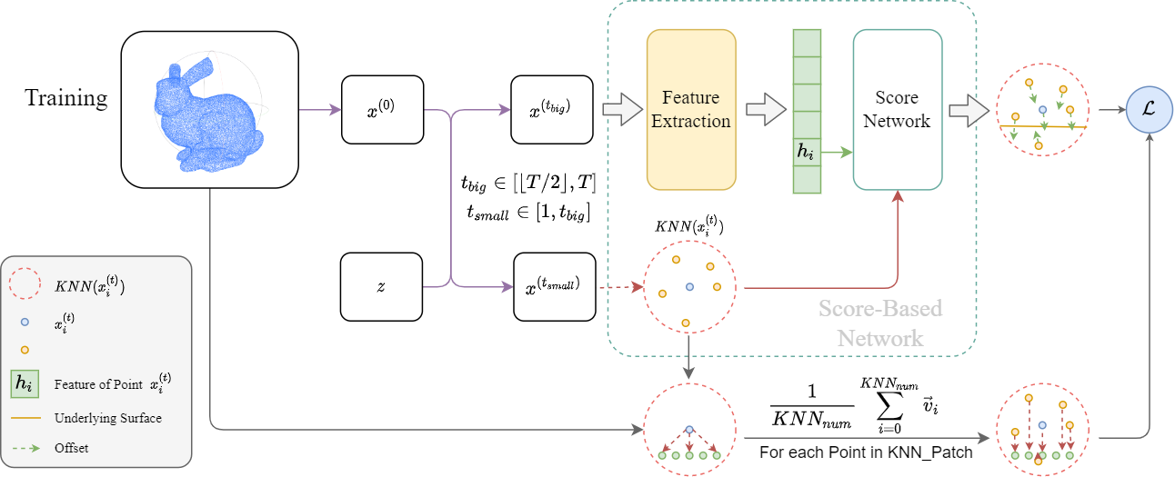

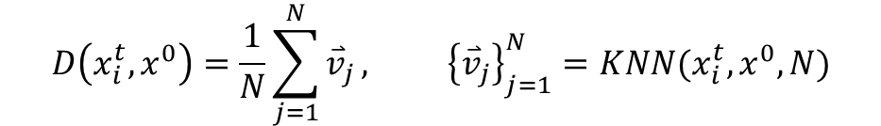
6. Potential Solution
Forward Process (Diffusion)
$$D\left(x_{i}^{t},x^{0}\right)=\frac{1}{N}\sum_{j=1}^{N}{{\overset{⃑}{v}}_{j}}, {\left\{{\overset{⃑}{v}}_{j}\right\}}_{j=1}^{N}=KNN(x_{i}^{t},x^{0},N)$$
$$ℒ\left(x_{0:T};{\left\{β_{i}\right\}}_{i=1}^{T}\right)=\sum_{i=1}^{L}{β_{t}^{2}𝔼_{x_{i}∈x^{(t_{s})}}\left[{\left\|∇_{x_{i}}\log{q_{ θ}\left(x^{{(t}_{s}−1)} | x^{{(t}_{s})},Feat\left(x^{{(t}_{b})}\right)\right)}−D(x_{i},x^{\left(0\right)})\right\|}_{2}^{2}\right]}$$

Slide 20
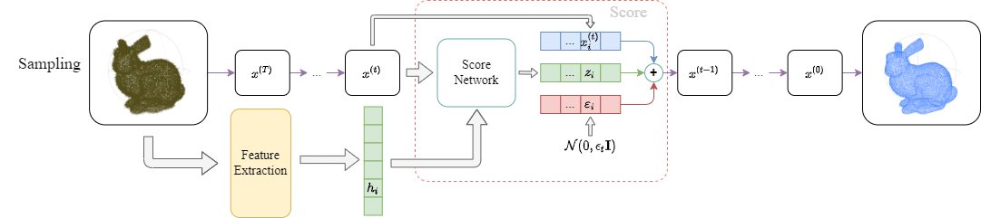

6. Potential Solution
Reverse Process (Sampling)
NCSE is an image generation model that combines Score-Based and Diffusion.
Multiple Score-based Langevin dynamics in one sampling of NCSE.
Associated Diffusion and Score-based models:
$∇_{\tilde{x}}\log{q_{σ}\left(\tilde{x} | x\right)=−\frac{\tilde{x}−x}{σ^{2}}}$
Sampling eq: (TODO Debug)
$$x^{(t−1)}=\frac{x^{(t)}+\sqrt{1−α_{t}}∇_{x^{(t)}}\log{q_{ θ}\left(x^{(t−1)} | x^{(t)},Feat\left(x^{(T)}\right)\right)}}{\sqrt{α_{t}} }+ε_{t}, ε_{t}∼𝒩(0,ε_{t}I)$$

Slide 21
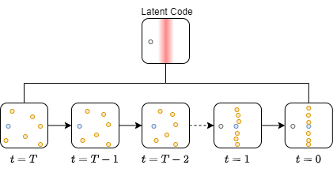
6. Potential Solution
What happens in the Sampling? (my view only)

Slide 22
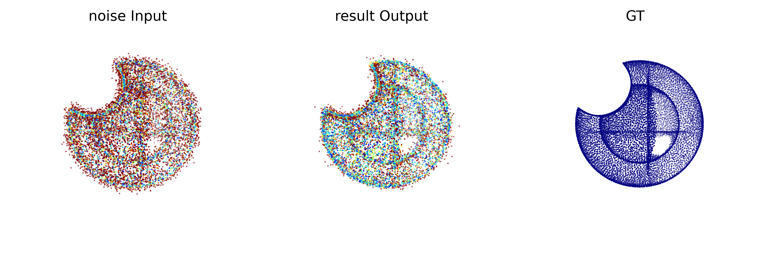
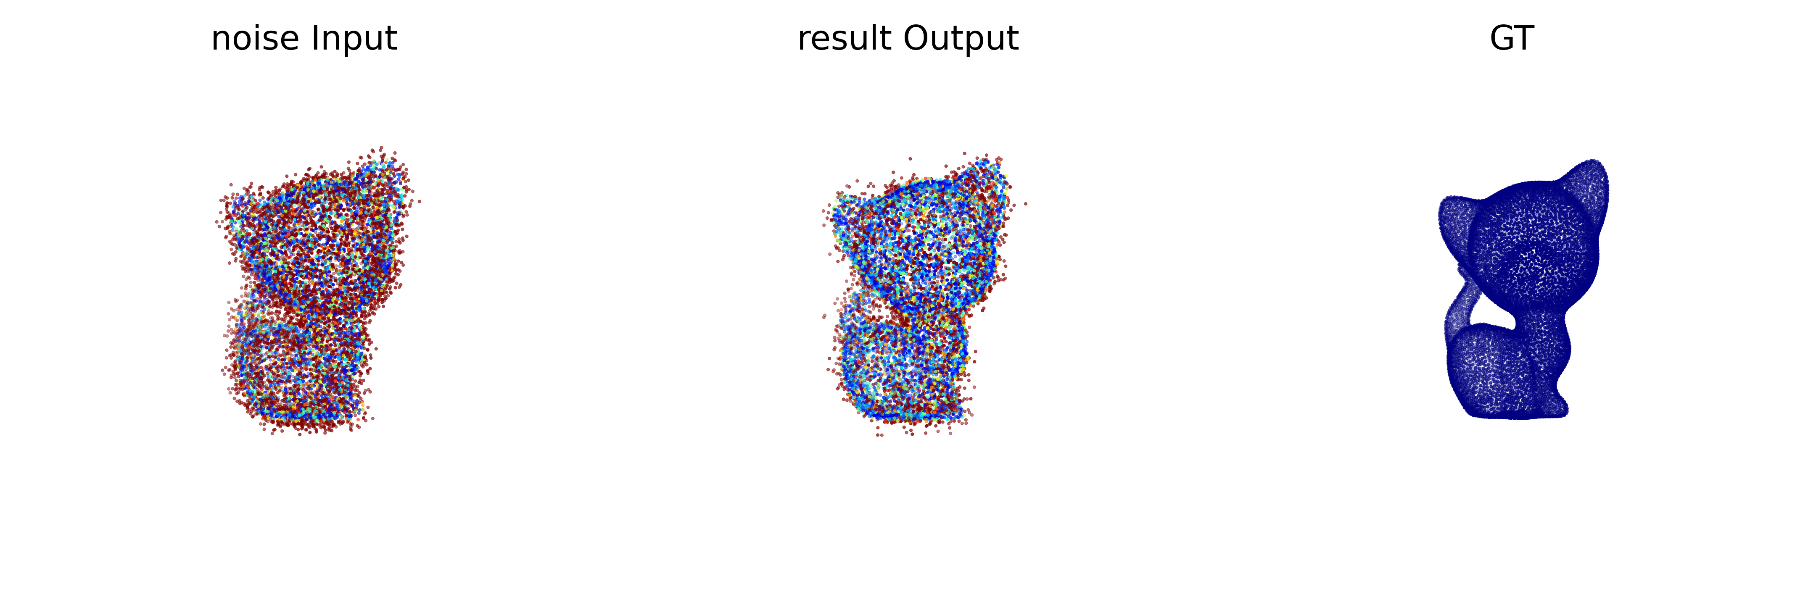
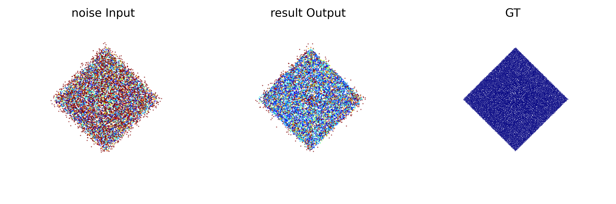
7. Unclear Problems
Current Results (Sampling needs refinement) (epoch=4000)

Slide 23
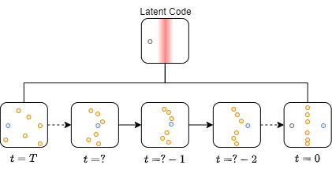
7. Unclear Problems
Where did the outlier come from? (my view only)
Tunneling conjectures due to step lengths:
Current solution: Modify sampling method.

Slide 24
8. TODO-List
TODO-List
Modify sampling method.
Explore the possibilities of Score-based diffusion for high-detail denoising.
Find other novelty.
…

